Slide 1
Google Earth Initiative
William Ganley, James Warner, Michael Shimony

Slide 2
Background
Initiative task to investigate Google Earth
Standalone application versus browser plug-in
Standalone application uses COM API
Support ended in 2008 with the release of browser plug-in
Browser plug-in
JavaScript API
Support for
Windows (XP and Vista)
Mac OS X 10.5 and higher
Requires Internet connection for API
Google Earth is free for personal use
Google Earth Pro requires paid license for commercial uses
MSE Initiative used the free version

Slide 3
Pros and Cons
Pros
Easy to use
Robust API
Excellent documentation
https://developers.google.com/earth/documentation/reference/
Many examples online
Can use Google Maps API inside Google Earth
GeoCoding locations, driving directions, etc.
KML support in API
Useful as offline planning tool
Cons
Browser plugin support for Windows/Mac only
No mobile support (iOS, Android)
Requires internet connection
API functionality, map tiles, external KML data
Cannot support real-time updates
Transaction limits
Free version has transaction limits for certain functionality (e.g. geocoding)
Google Earth Pro license $400/year
Less transaction limits

Slide 4
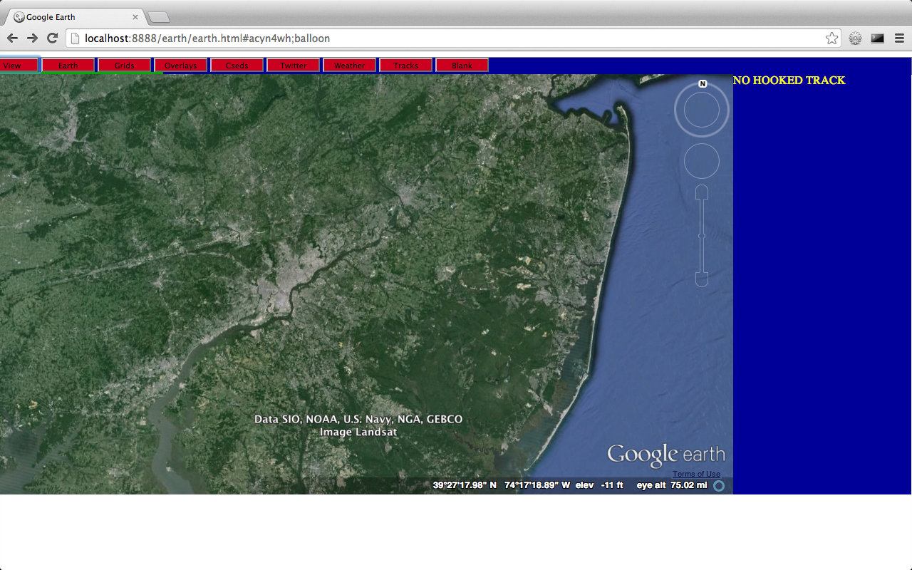
Prototype Design
Laptop running MAMP
MySQL
HTML/JavaScript/CSS
Apache Webserver
Ajax/JSON
PHP/JSON

Slide 5
Prototype Code
Code
52 html files
39 php files
4 css files
All code saved to https://github.com/MissionSE/Initiatives

Slide 6
Features explored under MSE Initiative
Google Earth control from browser windows
View Control
Offset view
Locations (name, address, position), tracks
Range in/out
Camera tilt
Google Earth built-in features
Sunlight coverage
Inset Map
Roads, borders, buildings, terrain, atmosphere
Earth/Sky map
Lat/Lon grid
Display of KML information
Downloaded KML files for many features

Slide 7
Features explored under MSE Initiative
Custom built features
Tracks
Mil-Std 2525B track symbols
Image files dynamically requested from website
http://dev.bridgeborn.com/symbology
Add/Modify/Delete
Simulator
Symbol sizes
Tags
Filter (category and id)
Weather Feed
Twitter integration
Range rings
Remote control of GE
View tour created in standalone application
Add/Delete operator entered tours
Save lat/lon, range, camera tilt of selected locations for playback via KML

Slide 8
Demo

